Slide 1
Speaking-Kapitel 1-Stufe 1 Interview
Section 1-1 Interview
1st Attempt!

Slide 2
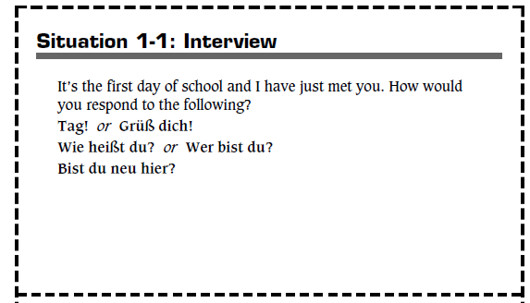

Slide 3
It’s the first day of school and I just met you. How would you respond to the following?
Tag or Grüβ dich!
Wie heiβt du?

